Slide 1



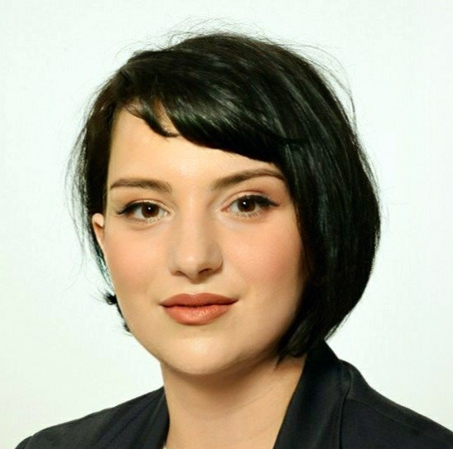
Eco-Nano Innovators Group:
Green Nanoparticles for Medical & Environmental Solutions
Contact person/Group leader:
Prof.Ass.Dr. Nimet Orqusha
Affiliation
Faculty of Medicine, University of Prishtina, Kosovo
Rr. Bulevardi i Dëshmorëve, p.n. 10 000 Prishtinë, Republika e Kosovës
Mail address
nimet.orqusha@uni-pr.edu
Email/website
https://staff.uni-pr.edu/profile/nimetorqusha
Group Members
Prof.Ass.Dr.Nimet Orqusha; Dr.sc.Aida Buza; Mr.Ph.Adhurim Bresa; Msc.Arbër Musliu, PhD; Arbër Dreshaj; Donika Veseli; Altin Dreshaj
Google Scholar
https://scholar.google.com/citations?user=lg-8cCsAAAAJ&hl=en
Research Gate
https://www.researchgate.net/profile/Nimet-Orqusha
Research lines
Green Nanoparticle Synthesis: Developing Sustainable Methods for Nanoparticle Production
Medical Applications of Green Nanoparticles: Enhancing Diagnostics and Treatments
Environmental Applications of Nanoparticles: Utilizing Green Nanoparticles for Pollution Remediation
Nanotoxicology and Safety Assessment: Evaluating the Impact of Nanoparticles on Health and the Environment

